Slide 1
Majlis Ansarullah
Monthly Meeting
August 2016
This slide deck contains images licensed for the purpose of this presentation only.
No one is permitted to use the images for any other use, without prior permission.

Slide 2
AGENDA
Recitation of the Holy Qur’an (33:71-72)
Pledge
Reminder: Why Recite Qur’an Everyday
Monthly topic: Qaule Sadeed (the right word) as a Basis for Matchmaking
Health topic: Hearing Loss
National Reminders/Announcements
Local Reminders/Announcements
Dua

Slide 3
Why read the Holy Qur’an regularly?
THE HOLY Qur’an IS THE BOUNDLESS SEA OF DEEP WISDOM
Let it be known that the most outstanding miracle of Holy Qur’an is that it is a boundless sea of deep wisdom. It carries those solid facts, those avenues of Qur’anic Knowledge so rich in philosophy which we manifestly present to all nations and people of every language: be the Indian, Persians, Europeans or Americans, whichever country they belong to. The Qur’anic miracle is capable of rendering them defenseless speechless and totally disarmed.
Roohani Khaza’in, vol 3, page 255

Slide 4
Watching Our Congregational Salat!
Reward is Twenty-Seven times More
The Prophet (saw) said: “Prayer in congregation is twenty seven times better than prayer prayed individually.”
(Sahih al-Bukhari and Sahih Muslim)

Slide 5

Qaule Sadeed and Arranging Marriages

Slide 6


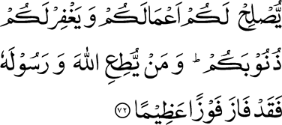
Surah Al-Ahzab (71-74)
Click to listen the recitation
[33:71] O ye who believe! fear Allah, and say the right word.
[33:72] He will bless your works for you and forgive you your sins. And whoso obeys Allah and His Messenger, shall surely attain a mighty success.

Slide 7
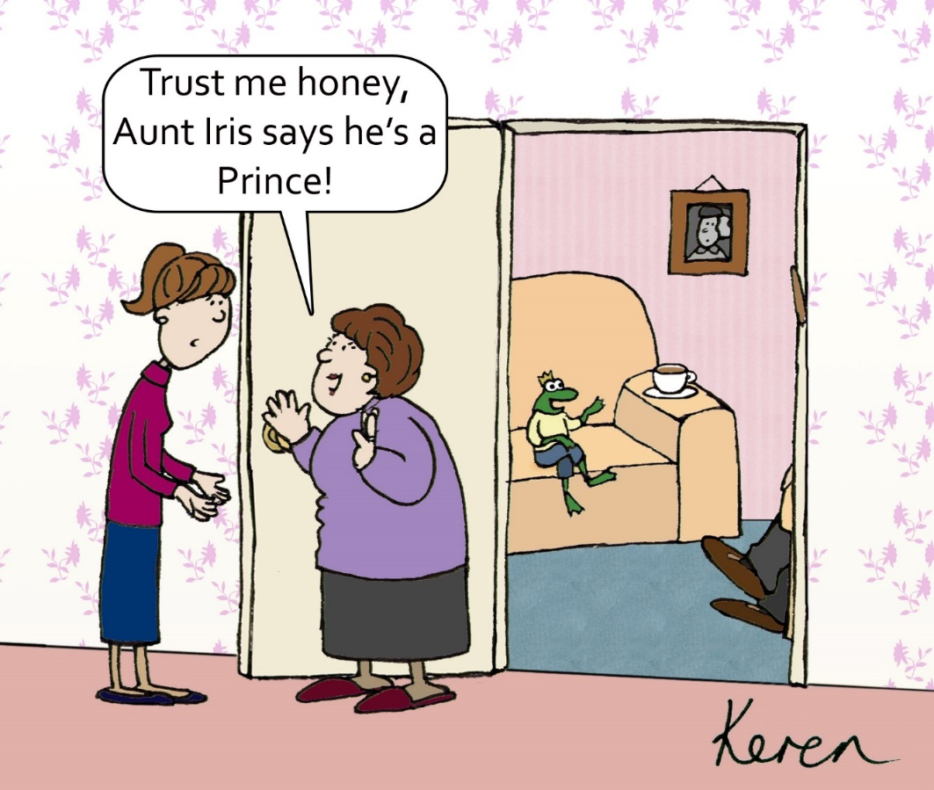
What does it mean to use Qaule Sadeed (the right word) in arranging our children’s marriages?
Share Your Thoughts!

Slide 8
From the writings of the Promised Messiah
‘Qaule Sadeed (the right word) entails uttering what is completely true and appropriate and has no hint of randomness, uselessness and falsehood.’
‘O you who believe, fear God and say what is based on truth, honesty, fairness and wisdom.’
‘Do not talk randomly and speak at the right time and place.’
Tafseer Holy Qur’an, Vol. III, pp. 731 – 732

Slide 9

Your niece just turned thirty-six years old and is still unmarried. She’s educated, pious, but rather overweight, which you suspect has made it difficult to find a suitable match. There is a 42-year old man in your Jama’at whose mother has been eager to get him married. She’s known to be very picky and only wants her son marrying a young girl in her late twenties so they can have many children. Your aging brother and sister-in-law are desperate to get their daughter married and advise you to just say your niece is “about 30.”
Discussion I

Slide 10
When you speak with the man’s mother:
Option 1: You should give the exact age of your niece.
Option 2: You should do as your older brother and sister-in-law advised and be very vague about her age.
Option 3: You should avoid the age topic completely and just “sell” the great qualities of your niece.
Option 4: Any other response?

Slide 11
Guidance from Holy Prophet Muhammad (saw)
Blessings of Transactions
Hakim bin Hizam narrated that the Holy Prophet Muhammad (saw) said, Both parties in a business transaction have a right to annul it so long as they have not separated; and if they tell the truth and make everything clear to each other (i.e., the seller and the buyer speak the truth, the seller with regard to what is purchased, and the buyer with regard to the money) they will be blessed in their transaction, but if they conceal anything and lie, the blessing on their transaction will be eliminated.
Al-Bukhari Book 1, Hadith 59

Slide 12
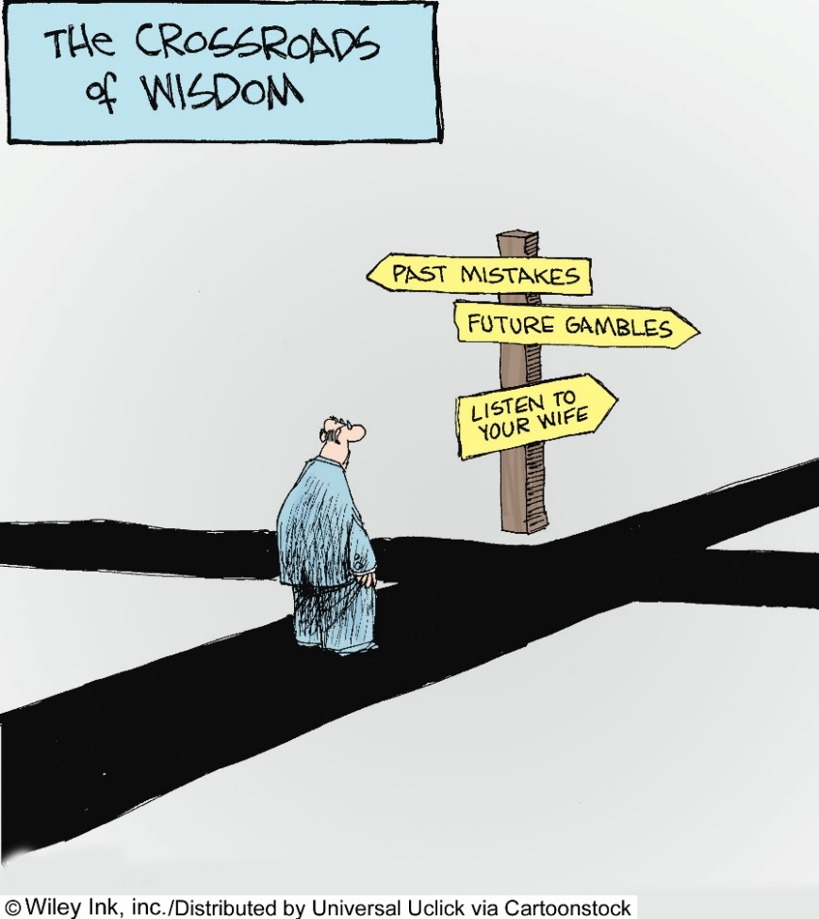
Your son completed his education and has a stable job. You and your wife are eager to marry him in a pious family. You receive a profile about a girl of the Jama’at from across the country. Your family (including your son) all agree that it seems to be suitably religious, attractive, and smart proposal. As you prepare to talk with her parents to set up an initial meeting, you need to decide with your wife about one potential challenge: do you divulge the fact about your son’s one-year relationship with a non-Muslim girl in college? That relationship has completed ended and your son is committed to the current process.
Discussion II

Slide 13
You suggest to your wife when she speaks with the girl’s mother:
Option 1: To come clean about your son’s past on the phone call.
Option 2: To not bring up your son’s issue right now. Let the couple meet first and see if they like each other; then share the facts about your son’s past.
Option 3: To not bring up about your son’s past, unless expressly asked by the girl’s family.
Option 4: Any other response?

Slide 14
So said Hazrat Khalifatul Masih V (aba)
The fact is that so long as a person does not renounce the selfish motives which prevent him from telling the truth, he cannot be considered truthful. If a person tells the truth only when he stands to lose nothing, but tells a lie when his honor, property or life are threatened, how can he be considered better than children and the insane? Do minors and the insane not speak this kind of truth? There is hardly anyone in the world who would tell a lie without any motive. Therefore, the truth that is forsaken when faced with possible loss can never form part of true morals. The real occasion of telling the truth is when one apprehends loss of life or property or honor.
Conditions of Bait and Responsibilities of an Ahmadi

Slide 15
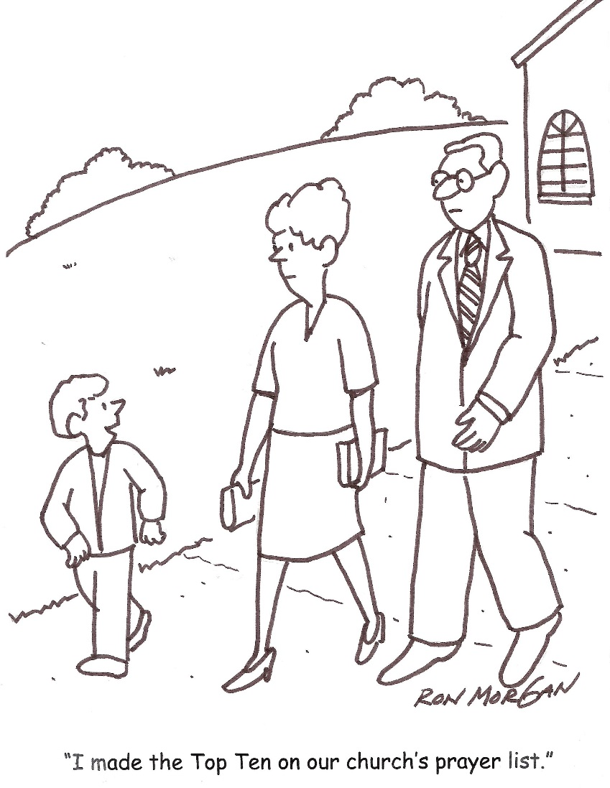
Discussion III
As the Jama’at president for the past several years, you have always been troubled by Tariq, the son of your Finance Secretary. Growing up, he’s always misbehaved during the children classes and has been disrespectful towards Jama’at elders. Now, in his early twenties, he’s completed some education and working odd jobs. He comes to the mosque for most programs, but he’s not very reliable and he keeps his distance from you. A family from across the country has come to get your opinion on him for their daughter.

Slide 16
What will you tell the prospective family about Tariq?
Option 1: Share your full history and opinion about Tariq: good and bad.
Option 2: Share your opinion about Tariq in a positive light.
Option 3: Share the basic Jama’at-related facts about Tariq: his Chanda regularity and frequency of attendance in Jama’at events
Option 4: Any other response?

Slide 17
Guidance from Huzoor (aba)
A benchmark of Qaule Sadeed (the right word) is that whatever one says is pertinent and appropriate. It is not essential to say everything that is true. If it is not pertinent and appropriate it can cause discord and strife. By divulging secrets of others relationships break down. However, at times something may not be appropriate in one situation but becomes necessary in another situation. For example, some matters are brought before the Khalifah of the time, which are for reformation. These matters are not for divulging in other situations but here their disclosure becomes pertinent and appropriate. A matter is pertinent and appropriate when something frivolous is not said in the name of Qaule Sadeed and no overstatement/exaggeration is made in the guise of explanation.
Friday sermon, June 21, 2013

Slide 18
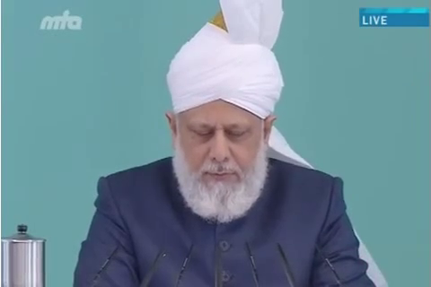
A Short Video from Friday Sermon, June 21, 2013

Slide 19
Translation of the Video
While drawing attention to attain Taqwa (righteousness), Allah Ta’ala commands to adopt Qaule Sadeed (the right word) and to say what is straightforward and clear. The Promised Messiah (as) wrote, ‘Qaule Sadeed means that you say what is completely true and appropriate and has no hint of randomness, uselessness and falsehood.’ Then he said again, ’O you, who believe, fear God and say what is based on truth, honesty, fairness and wisdom.’ The he says, ’Do not talk rubbish and only speak in the context and whenever needed’. In all these statements of the Promised Messiah (alaihissalam), it is apparent that the attainment of Taqwa, according to God’s commandment, is only possible when in every situation; in times of difficulty or ease, while making decision when someone is given the responsibility to make a decision, while giving testimony, while conversing and dealing with wife and children at home, and while dealing with relatives and friends, in business while buying and selling, in employment if someone is an employee, always uphold the truth. And if someone has employees, he should be truthful in dealing with them. So, in daily matters and in all situations, God commands to utter complete truth and without any ambiguity. Such ambiguity which leads one to take whatever meaning he wants.

Slide 20
اپنے جائزے لیں -
Self-analyze yourself
Where do we stand?
In the past,
Have you ever wrongfully sided your children to protect them in school, college, Masjid etc.?
Have you ever lied or distorted a fact in presence of your children to stay out of trouble?
Have you ever lied or distorted a fact at work for your benefit?
Count the number of Yes’s
(Keep it to yourself... the “score” is for you!)

Slide 21
How to Improve?
اپنے اندر پاک تبدیلیاں پیدا کریں -
Bring about pious changes in yourself
0
Combined Score
3
Alhamdulillah, keep praying for yourself that may Allah Ta’ala keep you on the right path
Keep struggling to always stick with the truth and keep praying that May Allah keep you away from falsehood
Pray hard for yourself and make a conscious effort to avoid distorting the facts at your next opportunity

Slide 22

Health Topic: Hearing Loss

Slide 23
What is hearing loss?
Hearing loss is a sudden or gradual decrease in how well you can hear. It is one of the most common conditions affecting older and elderly adults
Approximately 30% people between the ages of 65 and 74 have hearing loss and nearly 50% of those older than 75 have difficulty hearing
Hearing loss can be frustrating, embarrassing, and even dangerous
One may not be able to follow instructions by a physician, hear alarms, traffic sounds or simple day to day conversations. It can be terribly disabling and isolating

Slide 24
Why am I losing my hearing?
Many people lose their hearing slowly as they age. This condition is known as presbycusis. Hearing loss with aging affects some people more than others and it seems to run in families
Hearing loss with aging may be related to years of exposure to loud noise. This condition is known as noise-induced hearing loss. Construction workers, farmers, musicians, airport workers, Industrial workers and people in the armed forces have hearing problems even in their younger and middle years from long term noise exposure
Hearing loss can also be caused by viral or bacterial infections, heart conditions or stroke, head injuries, tumors, and certain medicines

Slide 25
What Can I Do?
Hearing problems can be serious. It is important to seek professional advice
Hearing aids are electronic instruments worn in or behind the ear. Things sound different when you wear a hearing aid. You may have to try more than one Hearing Aid to find the right kind - Request for a Trial Period of Hearing Aid
Cochlear Implants are small electronic devices surgically implanted in the inner ear that help provide a sense of sound to people who are profoundly deaf or hard-of-hearing
Assistive listening devices include phone amplifying devices, smart phone or tablet "apps," and closed circuit systems (induction coil loops) in places of worship, theaters, and auditoriums
Lip reading or speech reading can help some people too.
Ask your friends and family to face you when they talk so that you can see their faces
Ask people to speak louder and clearly but not shout
Background noise makes it hard to hear people talk e.g. Noise from TV etc. - Turn them off if you are not using those devices

Slide 26
National Reminders
Four Priorities for 2016
At least 50% of Tajnid to attend monthly meetings where we discuss our Khalifa’s vision: “Save yourself and your families from a fire” in interactive discussions.
Help establish a culture of congregational Salat.
Help strengthen the love of Holy Quran.
More than 50% Tajnid to attend National Ijtima. The National Ijtema and Shura will take place in BRM on Sep 23-25, 2016. Please start planning now

Slide 27
Local Reminders
Local Reminders
Dua

